Slide 1
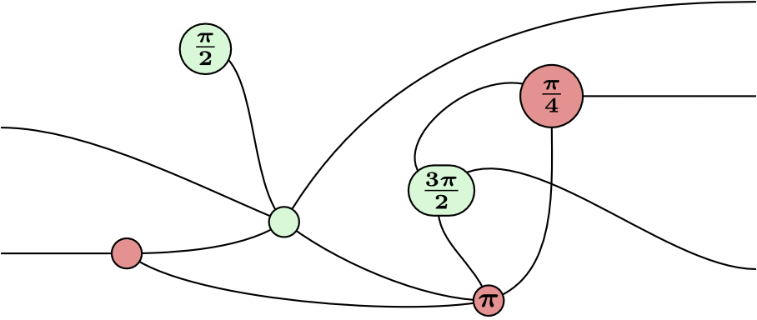
ZX-Calculus
Manuel Lerchner
07.06.2023

Slide 2
What is ZX-Calculus?
A way to represent Quantum Circuits
23
Graphical language
Rules for simplifying the Diagram

Slide 3
Applications
Quantum Circuit Optimization
T-Count Optimization
Circuit Compilation

Slide 4
Quantum Circuit Optimization
Idea: Transform circuits into equivalent circuits:
Goal: Fewer or simpler Gates
But why use ZX-Calculus for this?

Slide 5
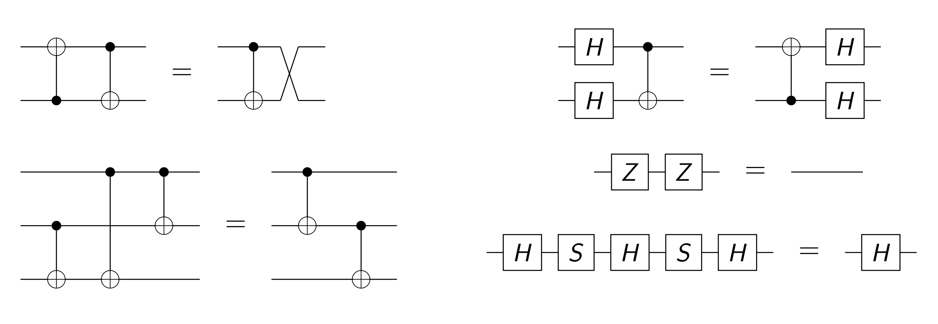
Classical Optimization
Fig. 2: Circuit Identities

Slide 6
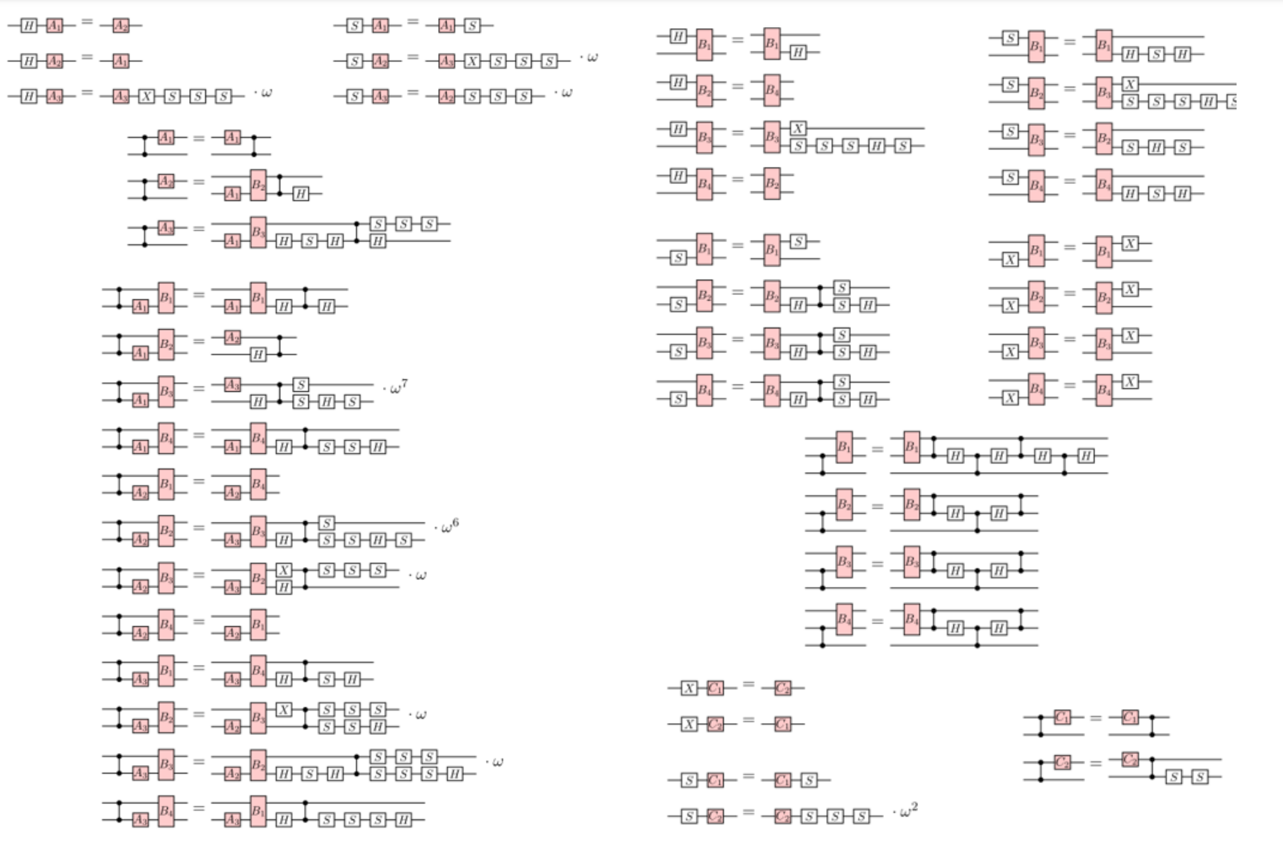
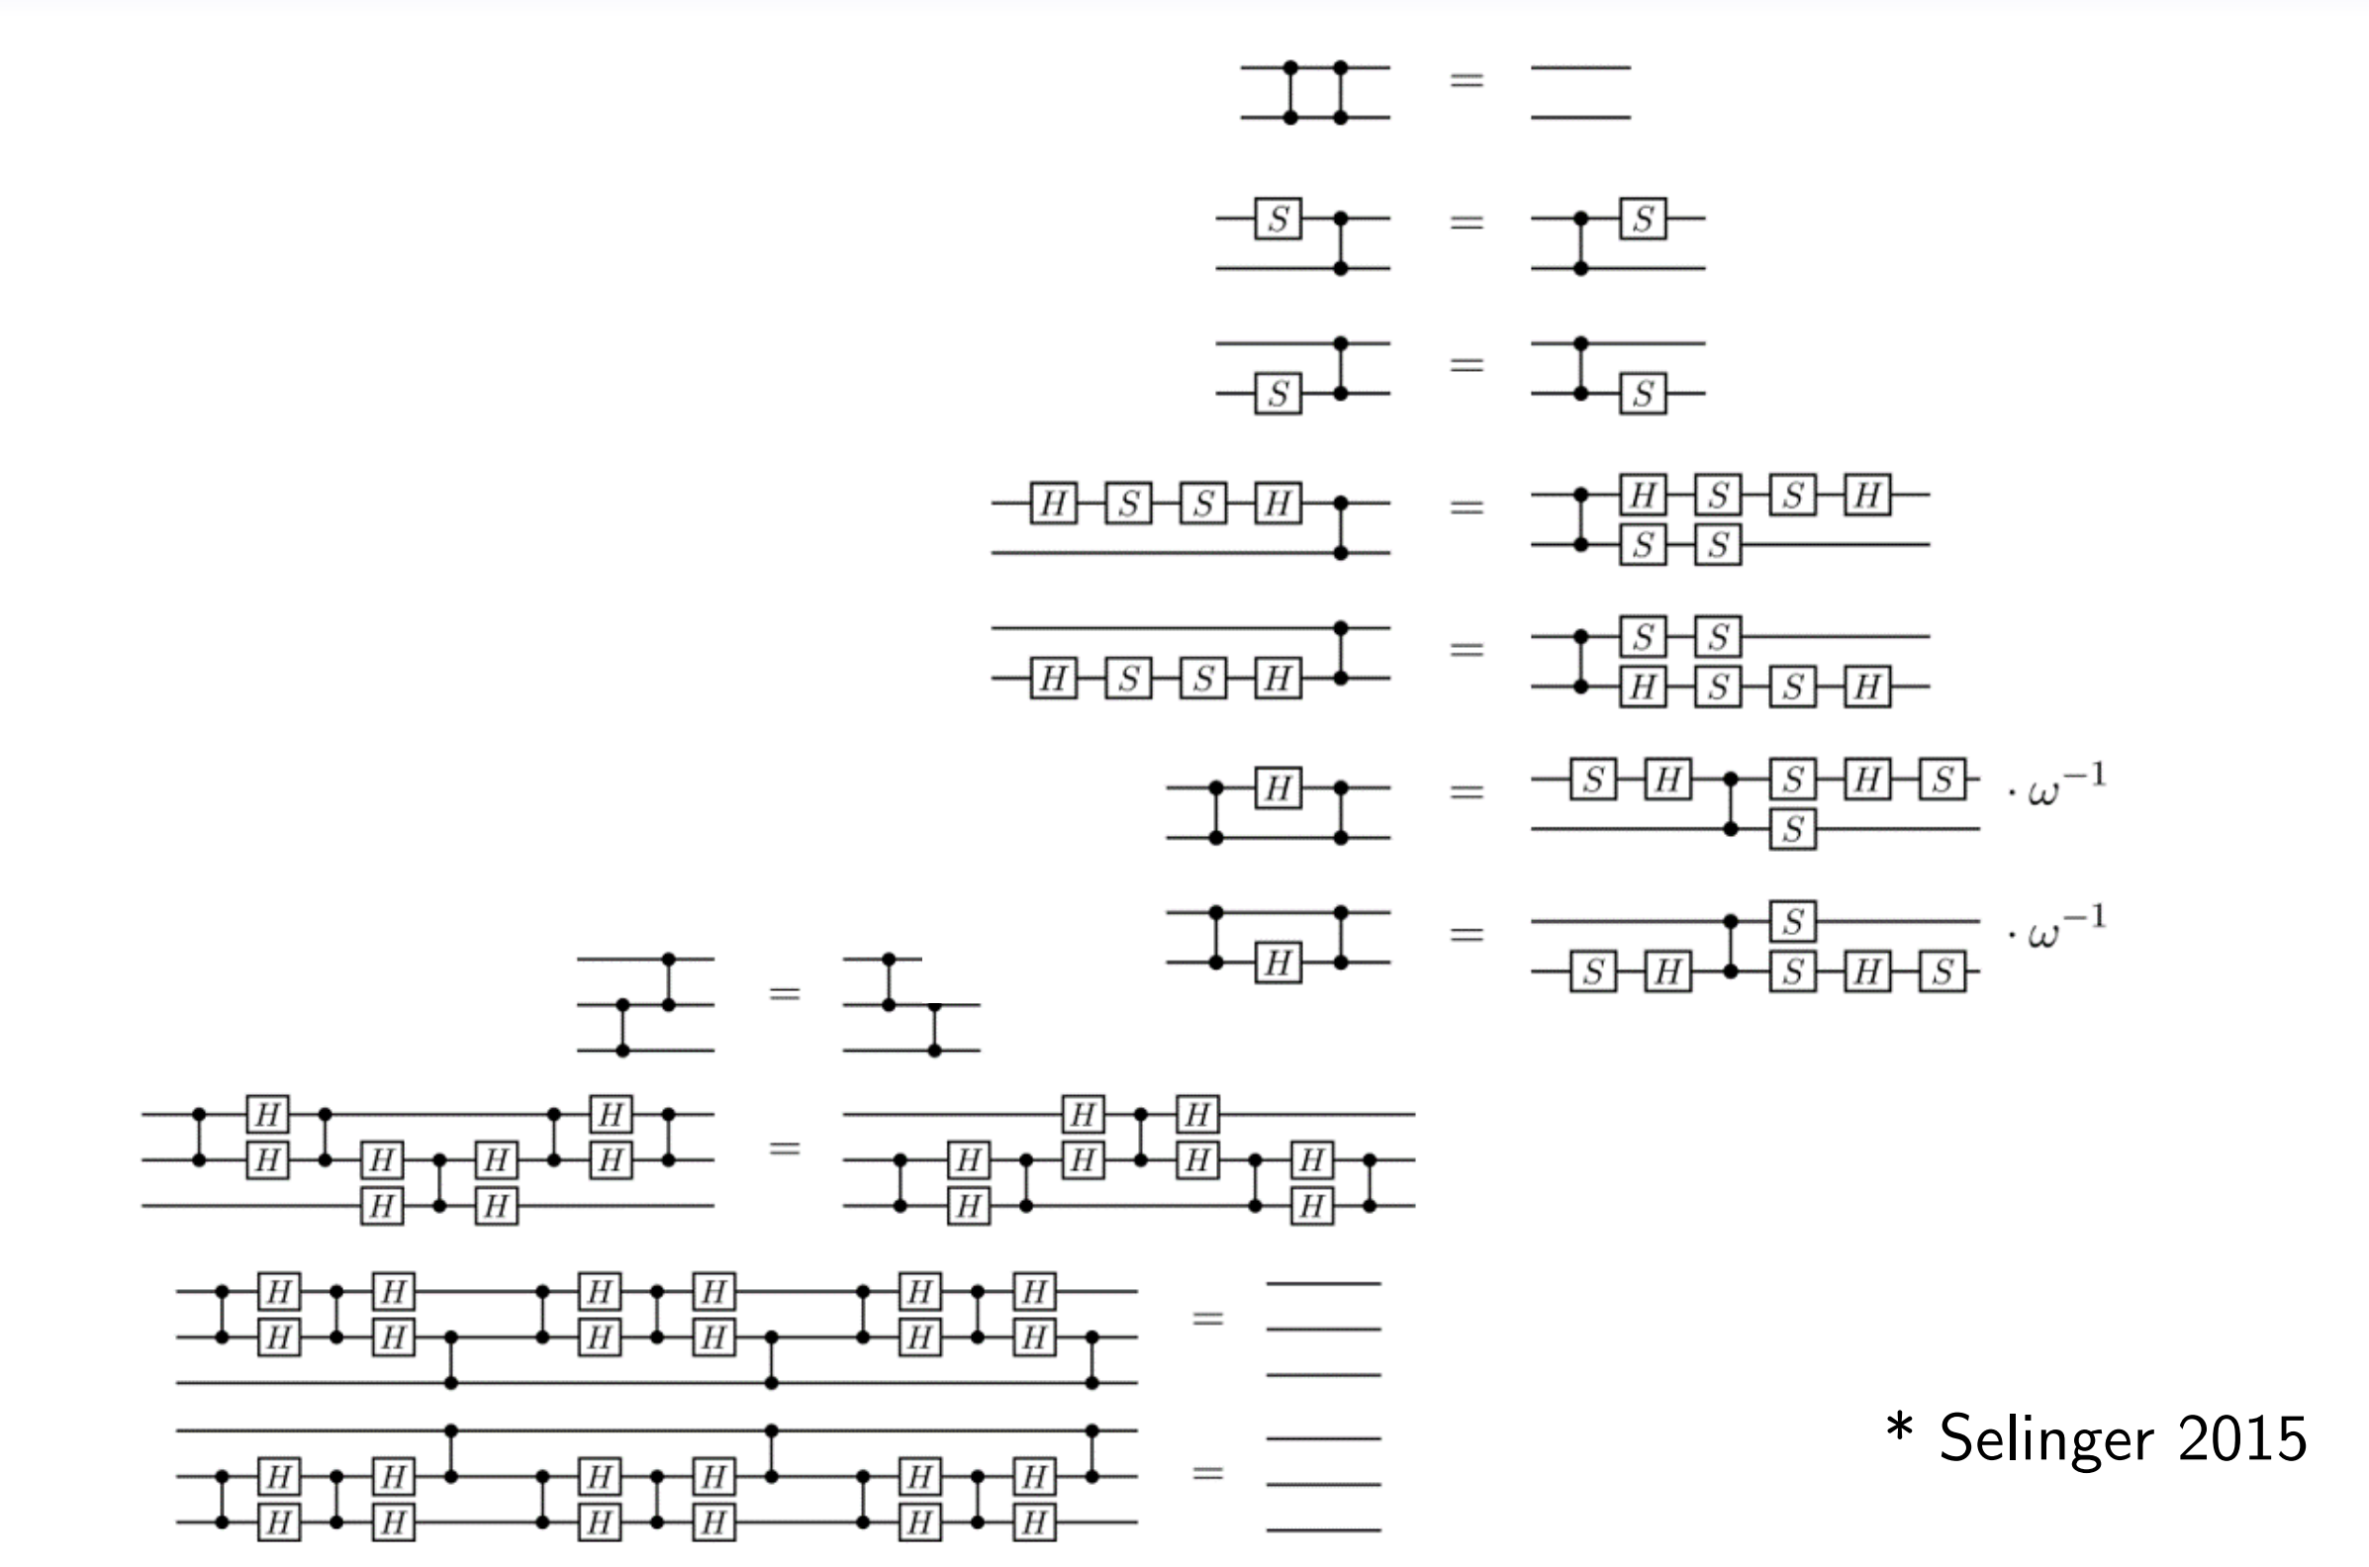
Classical Optimization
Fig. 2: Circuit Identities

Slide 7
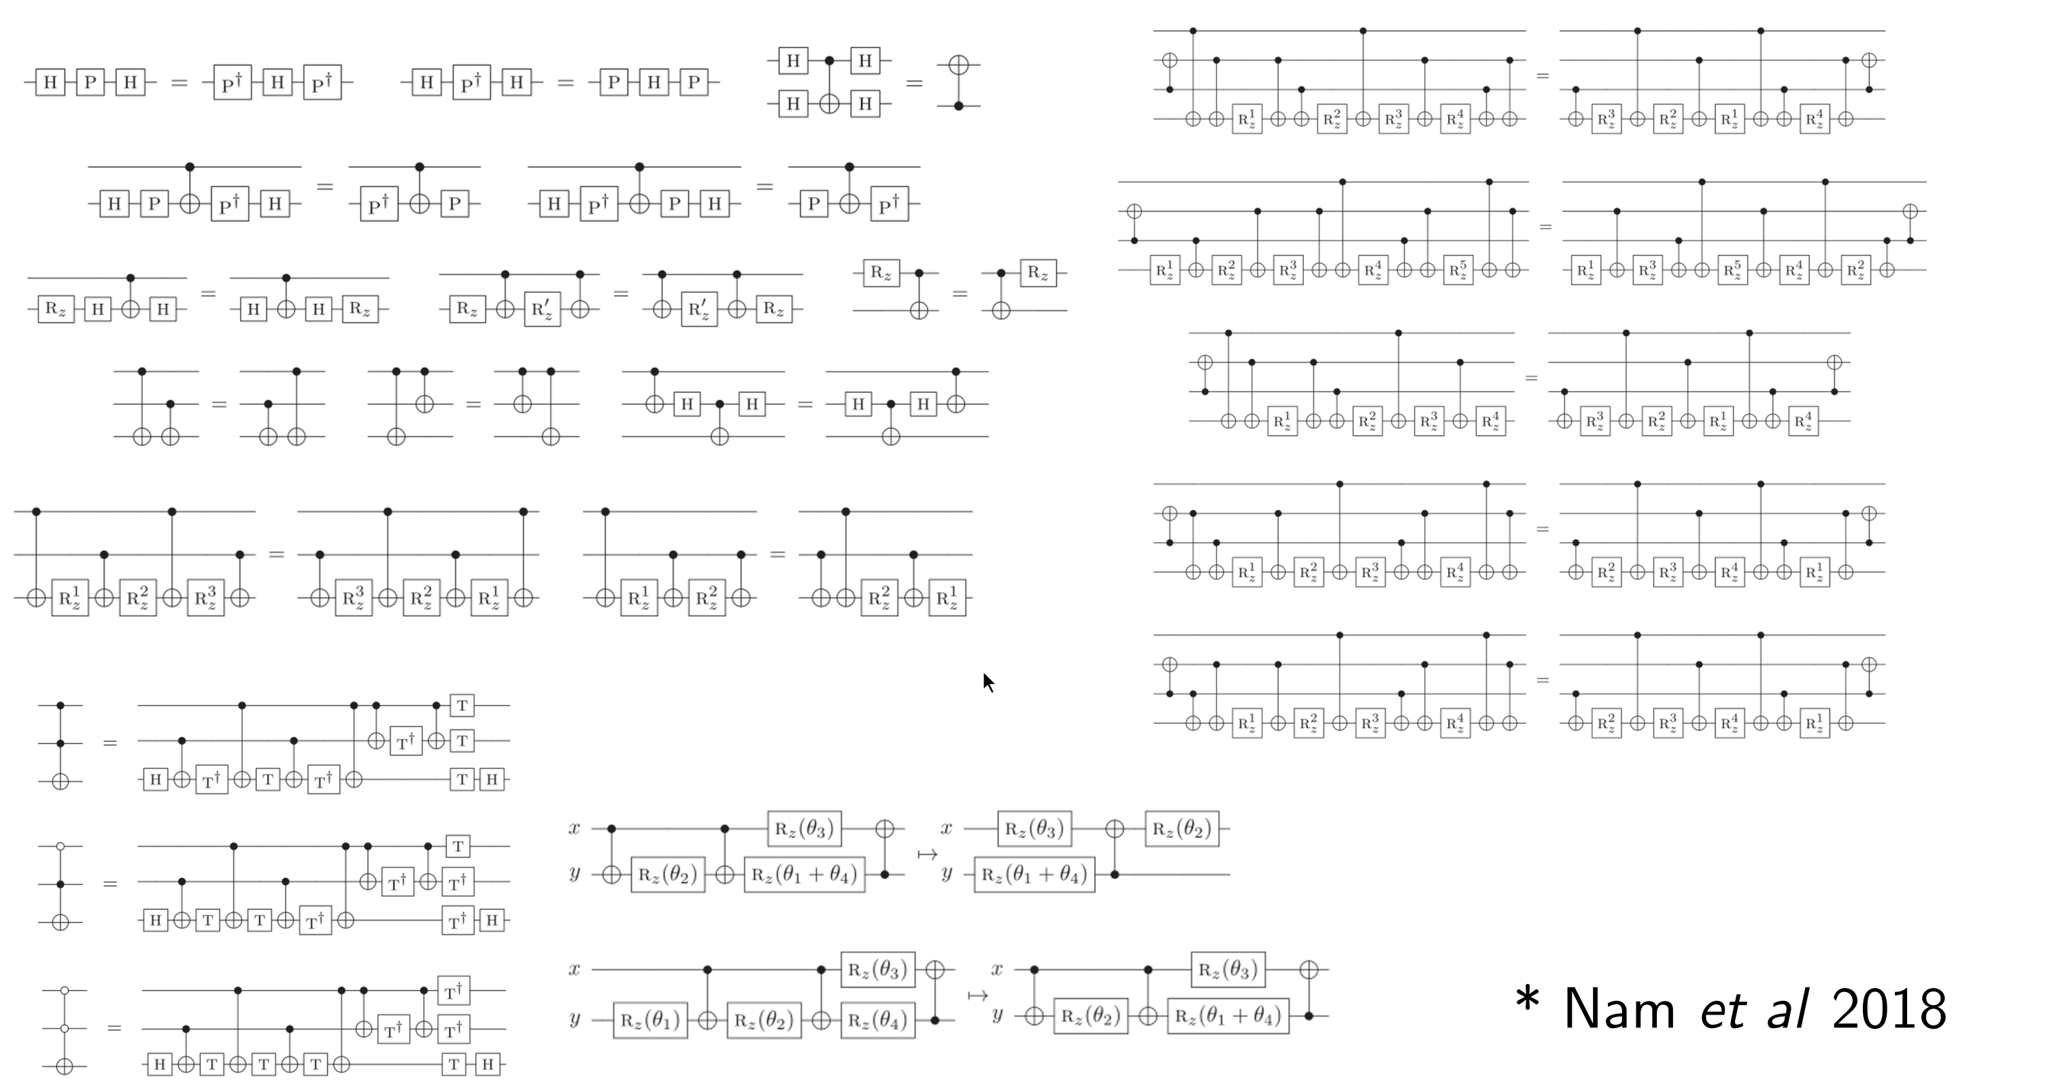
Classical Optimization
Fig. 2: Circuit Identities

Slide 8
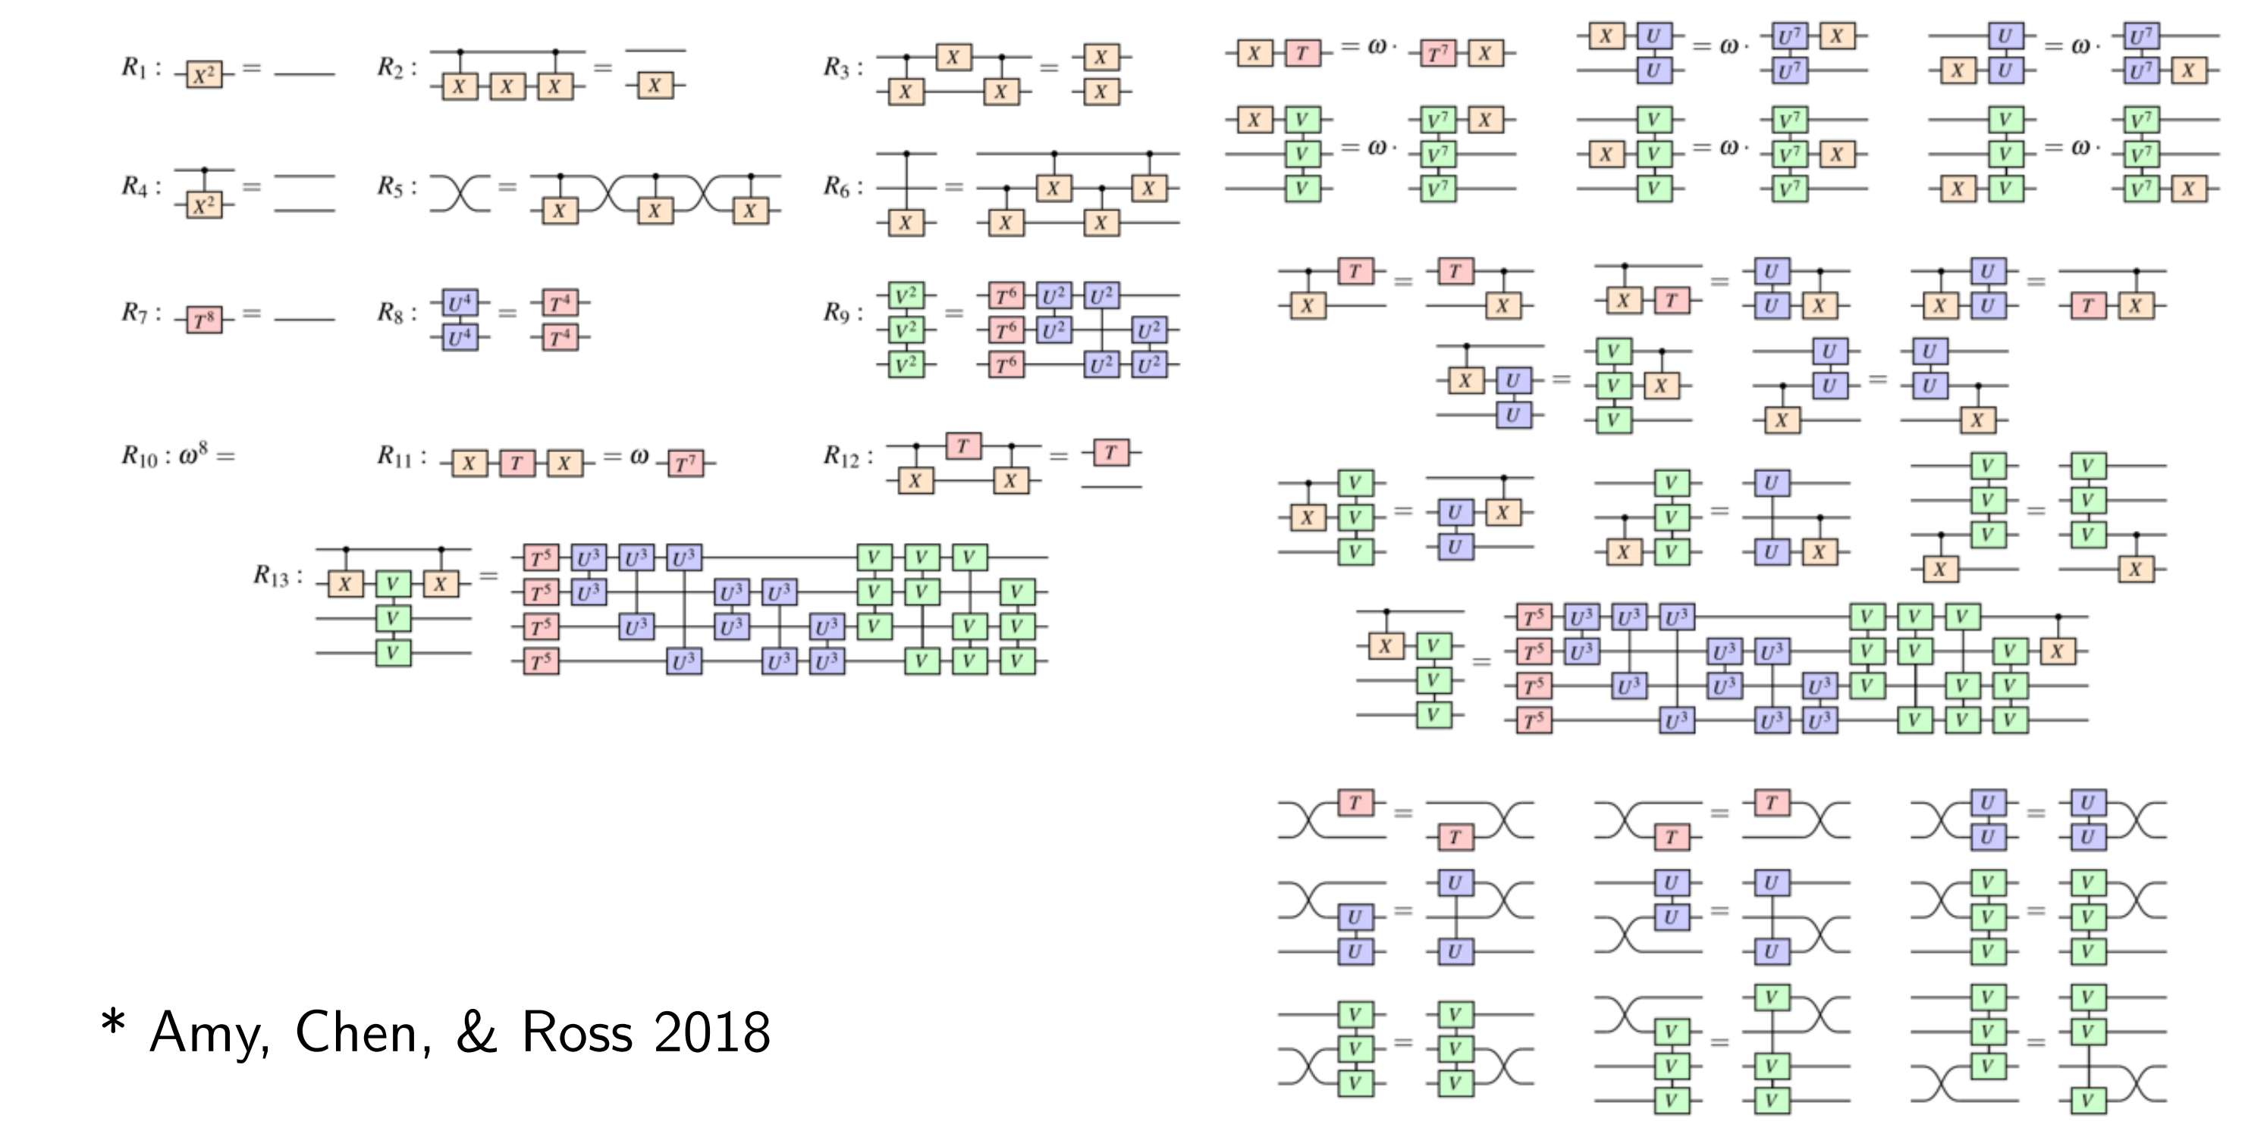
Classical Optimization
Fig. 2: Circuit Identities

Slide 9
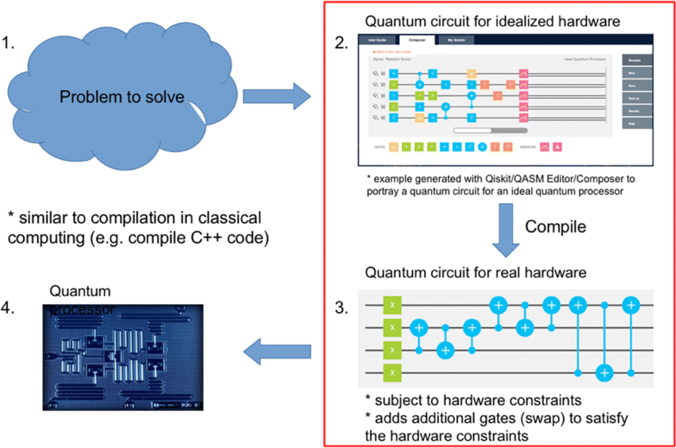
Compilation of quantum circuits
Circuits use many abstract gates
Problems of real quantum computers:
Limited set of gates
Limited connectivity between qubits
Fig. 3: Quantum Compilation

Slide 10
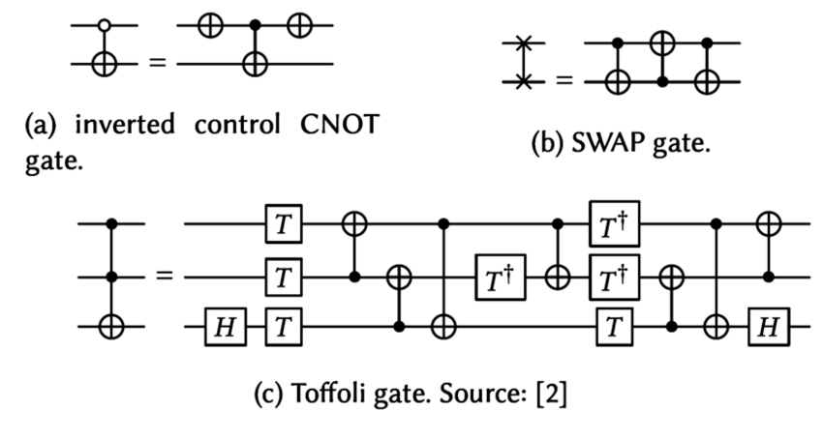
T-Count Optimization
Quantum computers are affected by noise
Clifford+T Circuits can be made tolerant to noise
Idea: Introduce Error Correcting Codes
Problem: Many new T-Gates need to be introduced
Difficult to simulate (Hardware Limits)
ZX-Calculus can simplify such circuits
Fig. 4: Fault tolerant Toffoli Gate

Slide 11
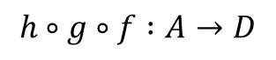
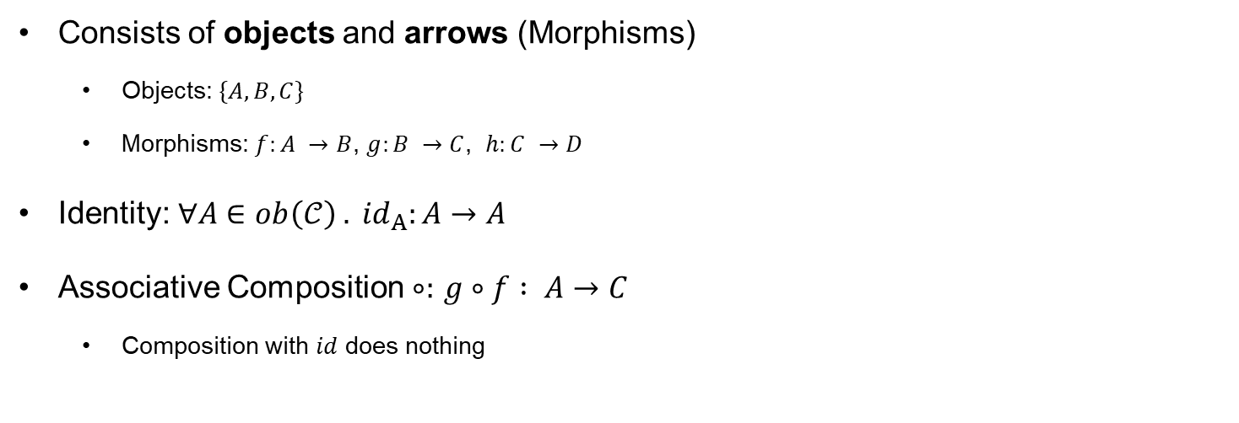
Mathematical Background: Category Theory
IMG SEQ
Consists of objects and arrows (Morphisms)
Objects: $\{A,B,C\}$
Morphisms: $f:A →B$, $g:B →C$, $h:C →D$
Identity: ${∀A∈ob\left(𝒞\right) . id}_{A}:A→A$
Associative Composition $∘:$ $g∘f : A→C$
Composition with $id$ does nothing
$$h∘g∘f :A→D$$

Slide 12
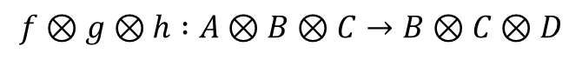
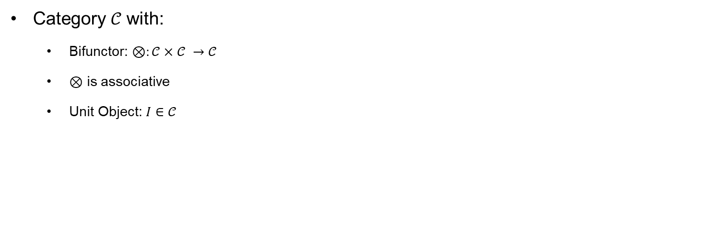
Monoidal Category
IMG PAR With ID
Category $𝒞$ with:
Bifunctor: $⊗:𝒞×𝒞 →𝒞$
$⊗$ is associative
Unit Object: $I∈𝒞$
$$f⊗g⊗h :A⊗B⊗C→B⊗C⊗D$$

Slide 13
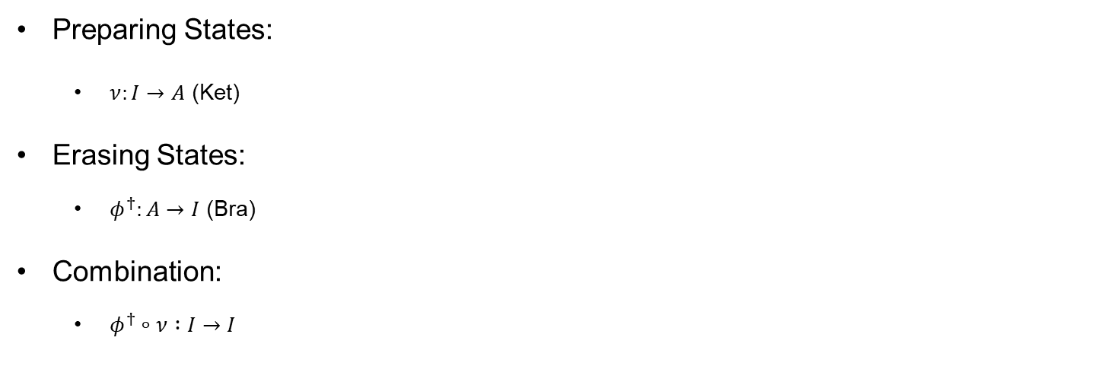
Monoidal Category
IMG Preparing / erasing
Preparing States:
$ν:I→A$ (Ket)
Erasing States:
$φ^{†}:A→I$ (Bra)
Combination:
$$φ^{†}∘ν :I→I$$

Slide 14
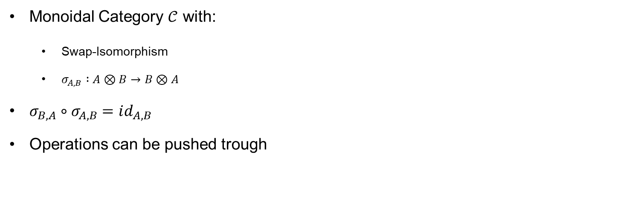
Symmetric Monoidal Category
SWAP
Monoidal Category $𝒞$ with:
Swap-Isomorphism
$σ_{A,B} :A⊗B→B⊗A$
$$σ_{B,A}∘σ_{A,B}=id_{A,B}$$
Operations can be pushed trough

Slide 15
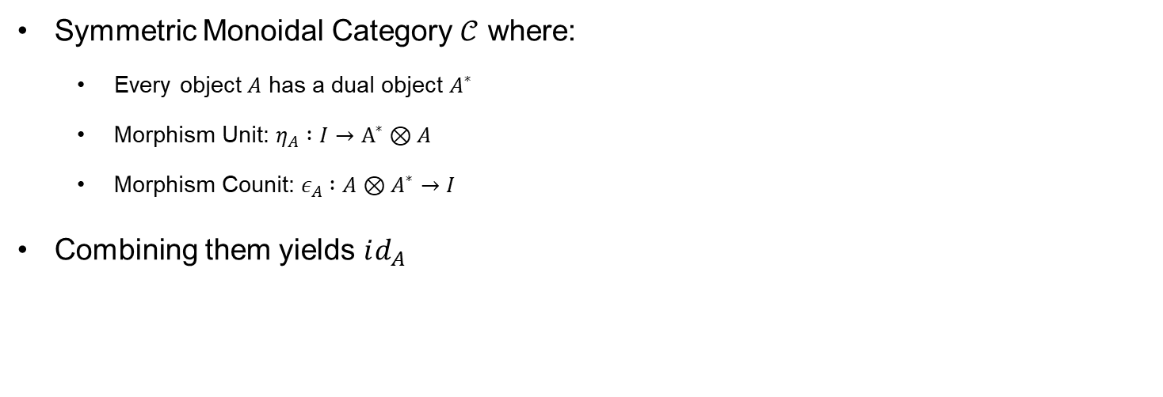
Compact Monoidal Category
CAP CUP
Symmetric Monoidal Category $𝒞$ where:
Every object $A$ has a dual object $A^{∗}$
Morphism Unit: $η_{A} :I→A^{∗}⊗A$
Morphism Counit: $ε_{A} :A⊗A^{∗}→I$
Combining them yields $id_{A}$

Slide 16
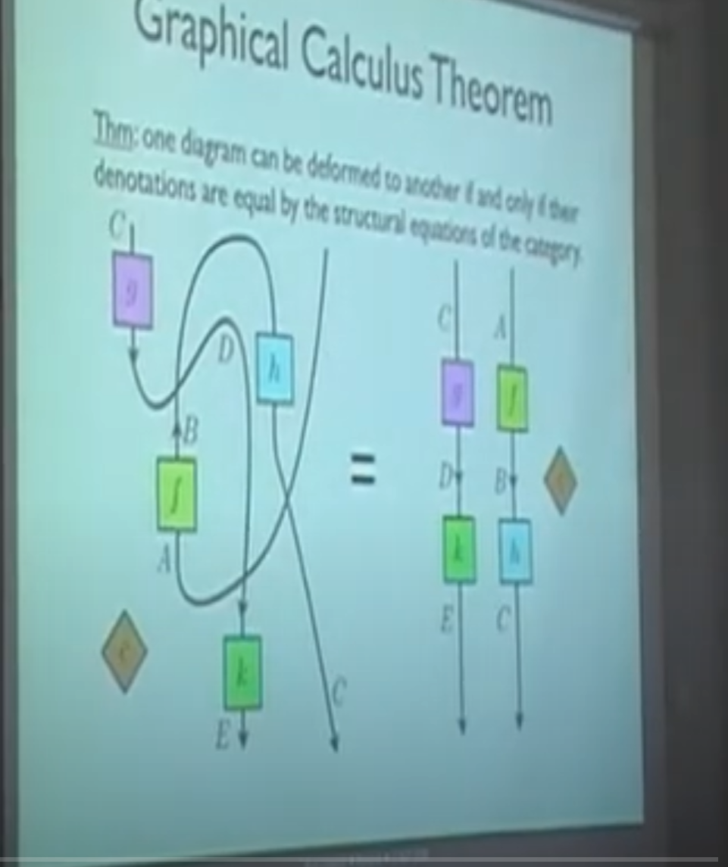
Graphical Calculus
Visually combine Elements of the Category
Process Theory
Main Idea of ZX-Calculus:
Represent Circuit as Network of Processes
Apply Simplifications on the Network
“Only topology Matters”
If it looks like the same graph its the same thing
Guaranteed by the rules of the Category

Slide 17
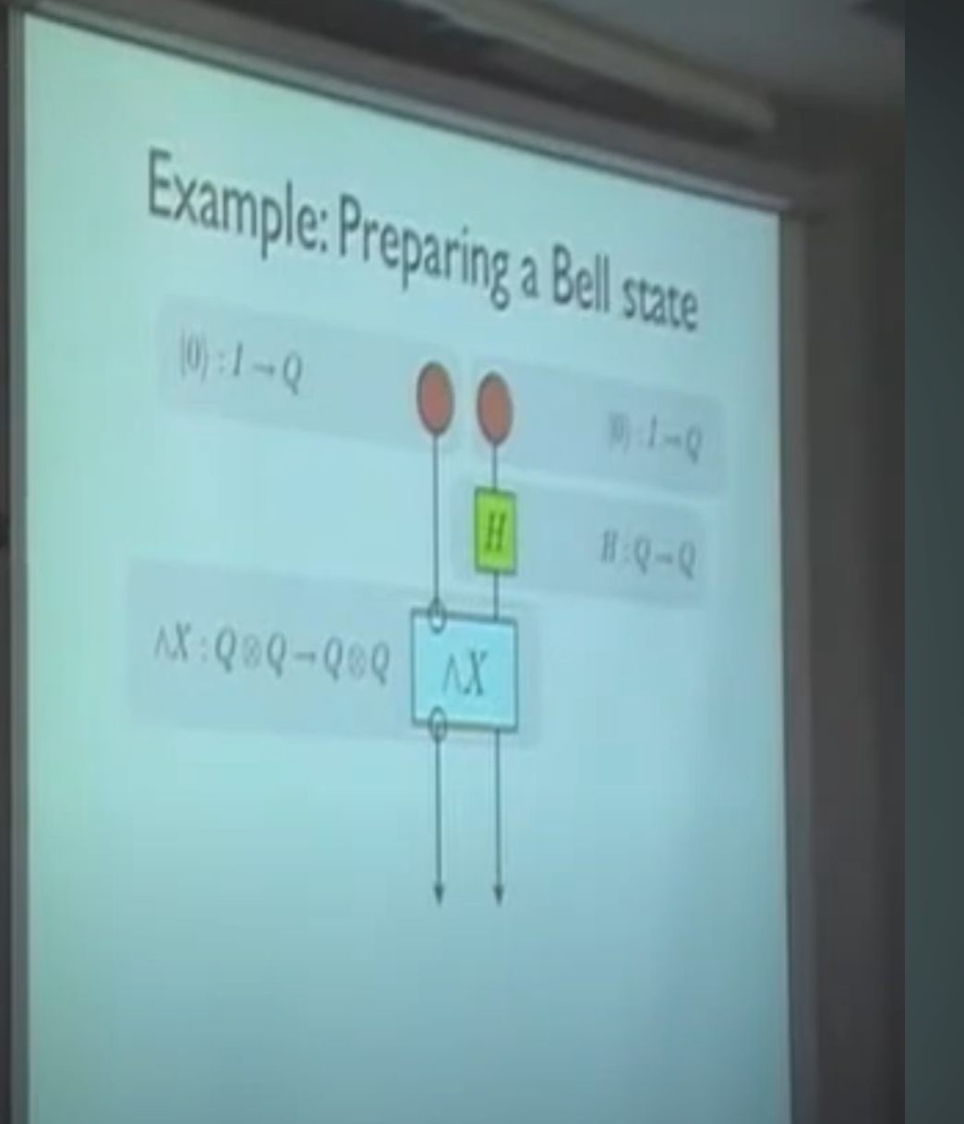
Example Network: CNOT
Prepare Qubits
Apply Hadamard
Apply CNTOT

Slide 18
ZX-Notation
Circuits can be represented visually
Everything is based on mathematical rules
The representation is very simple:
Spiders
Lines
We will see ZX-Calculus is universal

Slide 19
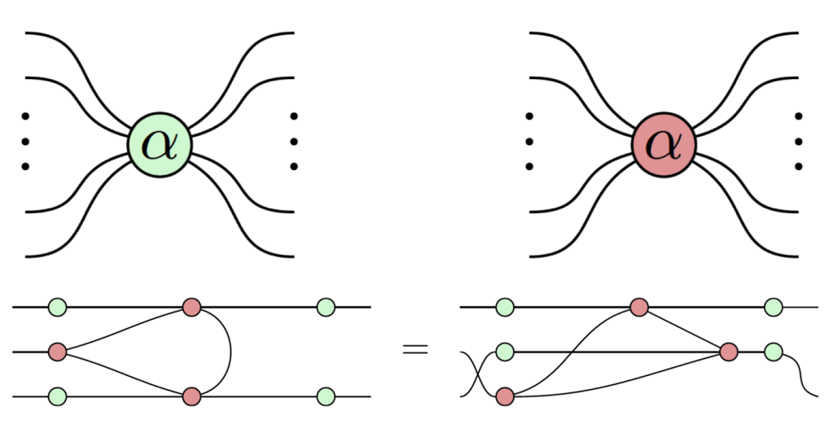
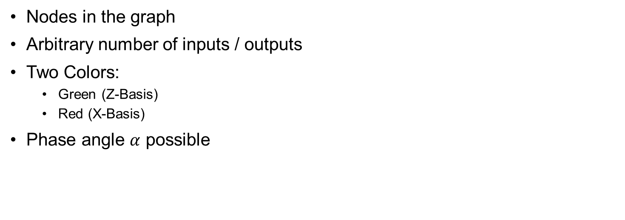
Spiders
Nodes in the graph
Arbitrary number of inputs / outputs
Two Colors:
Green (Z-Basis)
Red (X-Basis)
Phase angle $α$ possible

Slide 20
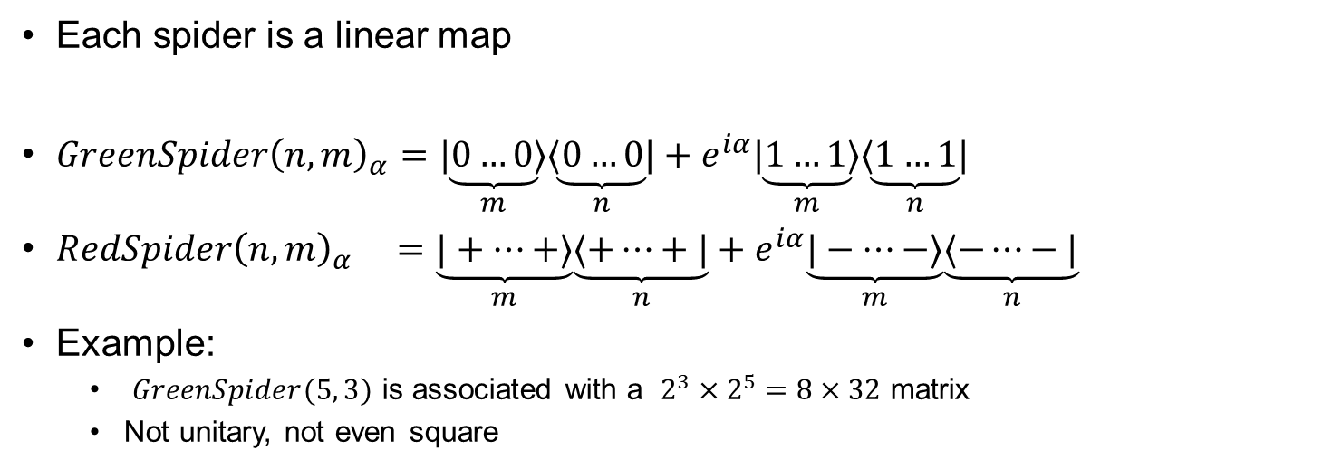
Spiders as linear maps
Each spider is a linear map
$$GreenSpider{\left(n,m\right)}_{α}=\underset{m}{\underbrace{|0…0⟩}}\underset{n}{\underbrace{⟨0…0|}} +e^{iα}\underset{m}{\underbrace{|1…1⟩}}\underset{n}{\underbrace{⟨1…1|}}$$
$$RedSpider{\left(n,m\right)}_{α} =\underset{m}{\underbrace{|+…+⟩}}\underset{n}{\underbrace{⟨+…+|}} +e^{iα}\underset{m}{\underbrace{|−…−⟩}}\underset{n}{\underbrace{⟨−…−|}}$$
Example:
$GreenSpider(5, 3)$ is associated with a $2^{3}×2^{5}=8×32$ matrix
Not unitary, not even square

Slide 21
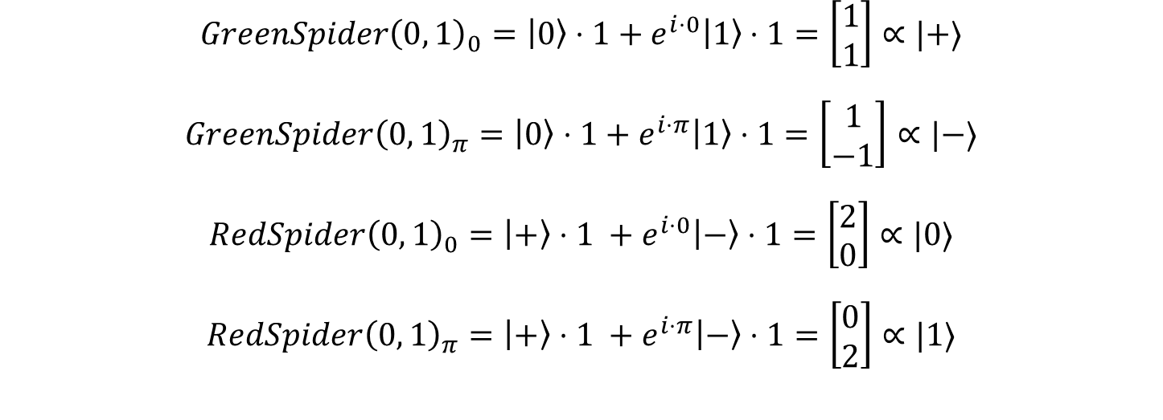
Example Spiders: Basis States
$$GreenSpider{\left(0, 1\right)}_{0}=\left|0\right\rangle ⋅1+e^{i⋅0}\left|1\right\rangle ⋅1=\left[\begin{matrix}1 \\ 1\end{matrix}\right]∝|+⟩$$
$$GreenSpider{\left(0, 1\right)}_{π}=\left|0\right\rangle ⋅1+e^{i⋅π}\left|1\right\rangle ⋅1=\left[\begin{matrix}1 \\ −1\end{matrix}\right]∝|−⟩$$
$$RedSpider{\left(0, 1\right)}_{0}=\left|+\right\rangle ⋅1 +e^{i⋅0}\left|−\right\rangle ⋅1=\left[\begin{matrix}2 \\ 0\end{matrix}\right]∝|0⟩$$
$$RedSpider{\left(0, 1\right)}_{π}=\left|+\right\rangle ⋅1 +e^{i⋅π}\left|−\right\rangle ⋅1=\left[\begin{matrix}0 \\ 2\end{matrix}\right]∝|1⟩$$
IMG
IMG
IMG
IMG

Slide 22
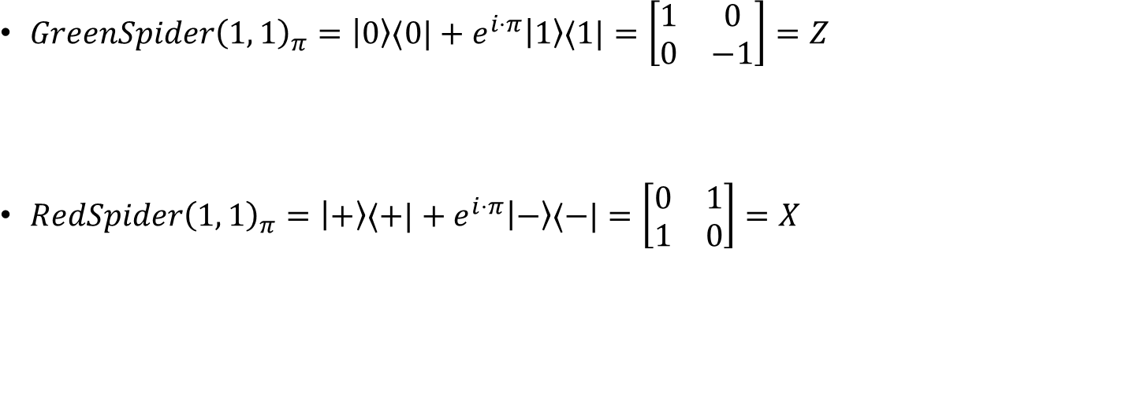
Example Spiders: Pauli Matrices
IMG
$$GreenSpider{\left(1, 1\right)}_{π}=\left|0\right\rangle ⟨0|+e^{i⋅π}\left|1\right\rangle ⟨1|=\left[\begin{matrix}1 & 0 \\ 0 & −1\end{matrix}\right]=Z$$
$$RedSpider{\left(1, 1\right)}_{π}=\left|+\right\rangle ⟨+|+e^{i⋅π}\left|−\right\rangle ⟨−|=\left[\begin{matrix}0 & 1 \\ 1 & 0\end{matrix}\right]=X$$
IMG

Slide 23
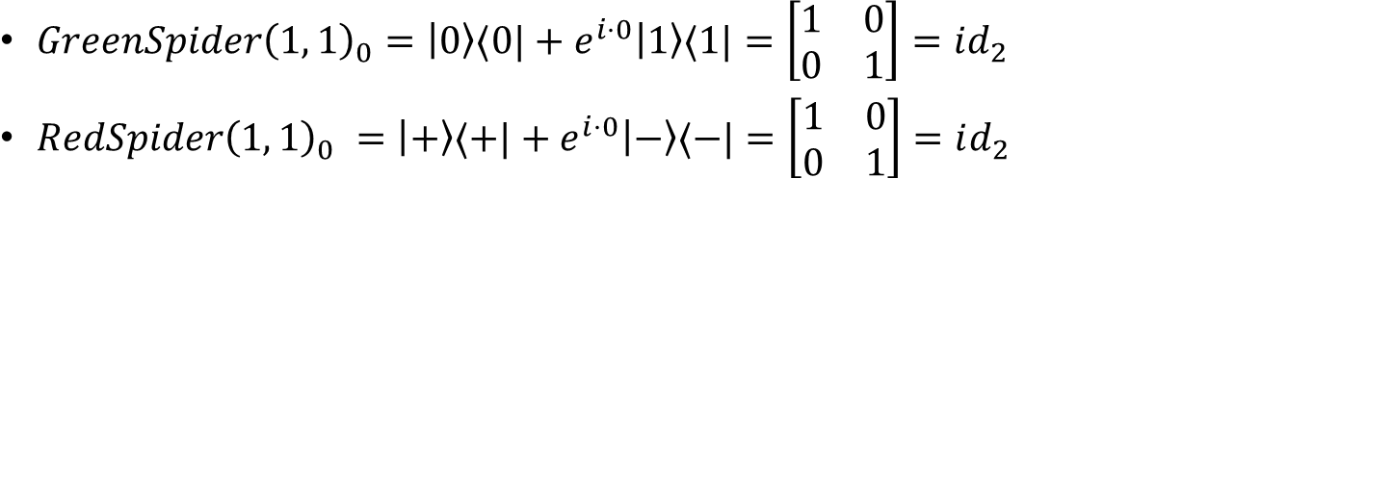
Example Spiders: Identity Matrix
$$GreenSpider{\left(1, 1\right)}_{0}=\left|0\right\rangle ⟨0|+e^{i⋅0}\left|1\right\rangle ⟨1|=\left[\begin{matrix}1 & 0 \\ 0 & 1\end{matrix}\right]=id_{2}$$
$$RedSpider{\left(1, 1\right)}_{0} =\left|+\right\rangle ⟨+|+e^{i⋅0}\left|−\right\rangle ⟨−|=\left[\begin{matrix}1 & 0 \\ 0 & 1\end{matrix}\right]=id_{2}$$
IMG
ID
Red IMG

Slide 24
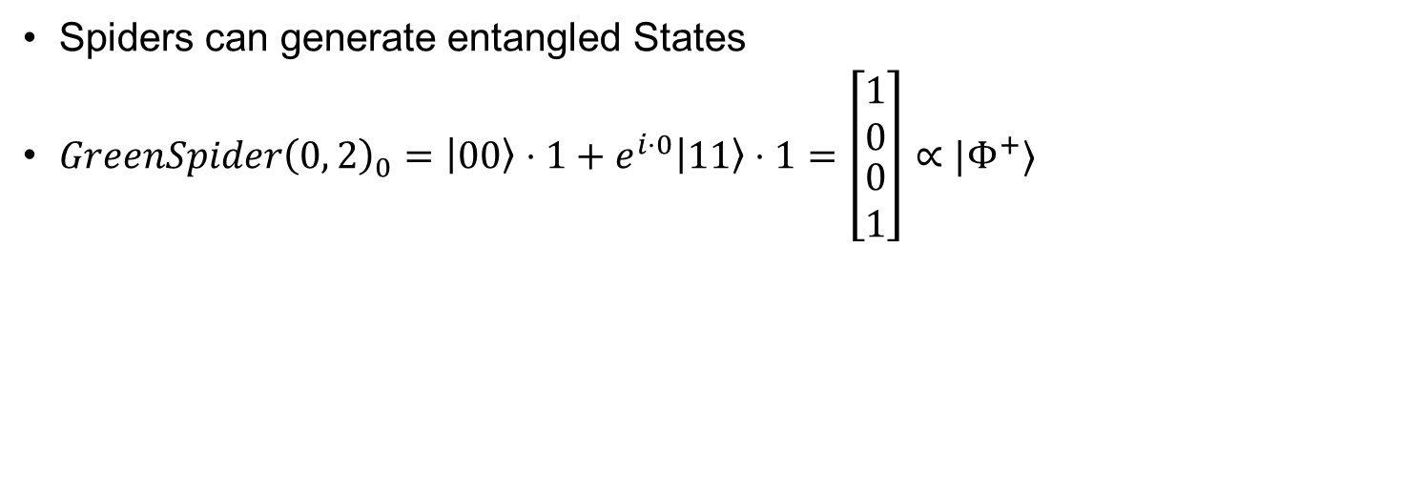
Example Spiders: Bell State
Spiders can generate entangled States
$$GreenSpider{\left(0, 2\right)}_{0}=\left|00\right\rangle ⋅1+e^{i⋅0}\left|11\right\rangle ⋅1=\left[\begin{matrix}\begin{matrix}1 \\ 0\end{matrix} \\ 0 \\ 1\end{matrix}\right]∝|Φ^{+}⟩$$
IMG

Slide 25



Combining Spiders
Connect output lines of a spider with input lines of another spider
Again: Only the topology matters
The resulting Graph can represent a Quantum Circuit
IMG
IMG

Slide 26

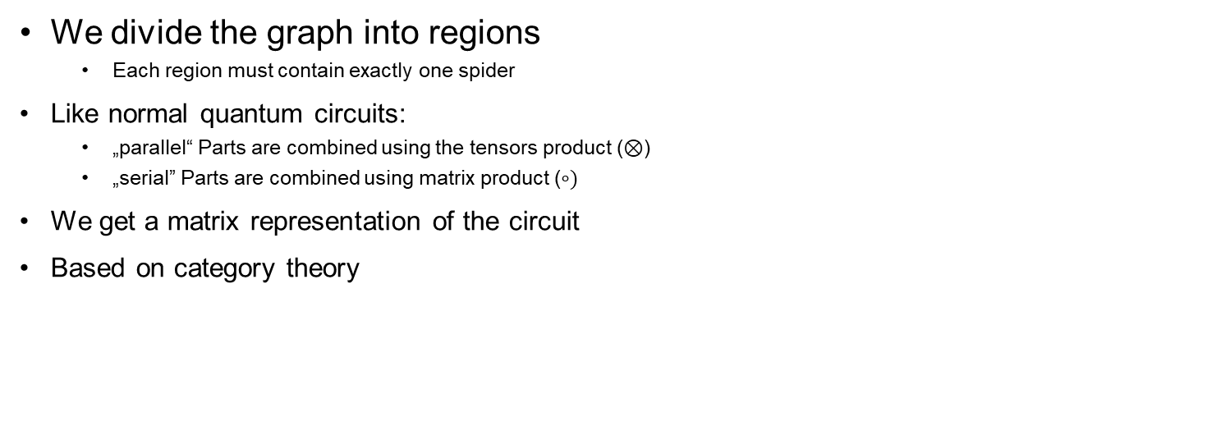


Evaluating a Graph of Spiders
We divide the graph into regions
Each region must contain exactly one spider
Like normal quantum circuits:
„parallel“ Parts are combined using the tensors product ($⊗$)
„serial” Parts are combined using matrix product ($∘)$
We get a matrix representation of the circuit
Based on category theory
IMG
IMG

Slide 27
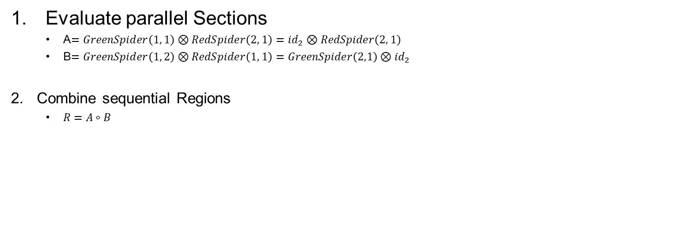
Example: CNOT
Evaluate parallel Sections
A$=GreenSpider\left(1, 1\right)⊗RedSpider\left(2, 1\right)=id_{2}⊗RedSpider\left(2, 1\right)$
B$=GreenSpider\left(1, 2\right)⊗RedSpider\left(1, 1\right)=GreenSpider\left(2,1\right)⊗id_{2}$
Combine sequential Regions
$$R=A∘B$$

Slide 28
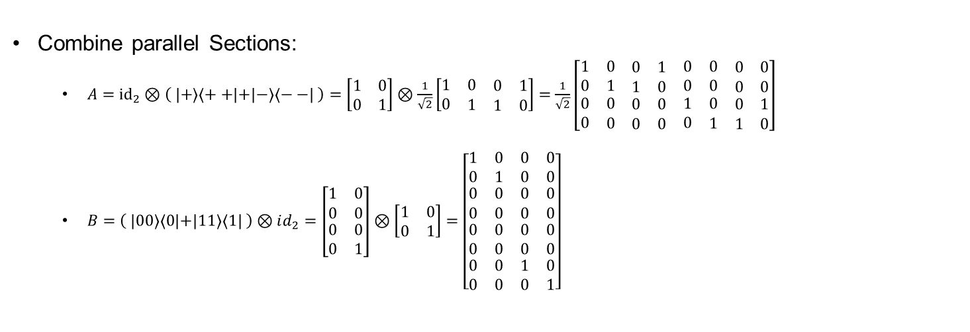
Example: CNOT
Combine parallel Sections:
$$A={id}_{2}⊗\left( | +\right\rangle \left\langle ++ | +\left|−\right\rangle \left\langle −−\right| \right)=\left[\begin{matrix}1 & 0 \\ 0 & 1\end{matrix}\right]⊗\frac{1}{\sqrt{2}}\left[\begin{matrix}1 & \begin{matrix}0 & \begin{matrix}0 & 1\end{matrix}\end{matrix} \\ 0 & \begin{matrix}1 & \begin{matrix}1 & 0\end{matrix}\end{matrix}\end{matrix}\right]=\frac{1}{\sqrt{2}}\left[\begin{matrix}\begin{matrix}1 & \begin{matrix}0 & \begin{matrix}0 & 1\end{matrix}\end{matrix} \\ 0 & \begin{matrix}1 & \begin{matrix}1 & 0\end{matrix}\end{matrix}\end{matrix} & \begin{matrix}0 & \begin{matrix}0 & \begin{matrix}0 & 0\end{matrix}\end{matrix} \\ 0 & \begin{matrix}0 & \begin{matrix}0 & 0\end{matrix}\end{matrix}\end{matrix} \\ \begin{matrix}0 & \begin{matrix}0 & \begin{matrix}0 & 0\end{matrix}\end{matrix} \\ 0 & \begin{matrix}0 & \begin{matrix}0 & 0\end{matrix}\end{matrix}\end{matrix} & \begin{matrix}1 & \begin{matrix}0 & \begin{matrix}0 & 1\end{matrix}\end{matrix} \\ 0 & \begin{matrix}1 & \begin{matrix}1 & 0\end{matrix}\end{matrix}\end{matrix}\end{matrix}\right]$$
$$B=\left( | 00\right\rangle \left\langle 0 | +\left|11\right\rangle \left\langle 1\right| \right)⊗id_{2}=\left[\begin{matrix}1 & 0 \\ 0 & 0 \\ \begin{matrix}0 \\ 0\end{matrix} & \begin{matrix}0 \\ 1\end{matrix}\end{matrix}\right]⊗\left[\begin{matrix}1 & 0 \\ 0 & 1\end{matrix}\right]=\left[\begin{matrix}\begin{matrix}1 & 0 \\ 0 & 1\end{matrix} & \begin{matrix}0 & 0 \\ 0 & 0\end{matrix} \\ \begin{matrix}0 & 0 \\ 0 & 0\end{matrix} & \begin{matrix}0 & 0 \\ 0 & 0\end{matrix} \\ \begin{matrix}\begin{matrix}0 & 0 \\ 0 & 0\end{matrix} \\ \begin{matrix}0 & 0 \\ 0 & 0\end{matrix}\end{matrix} & \begin{matrix}\begin{matrix}0 & 0 \\ 0 & 0\end{matrix} \\ \begin{matrix}1 & 0 \\ 0 & 1\end{matrix}\end{matrix}\end{matrix}\right]$$

Slide 29
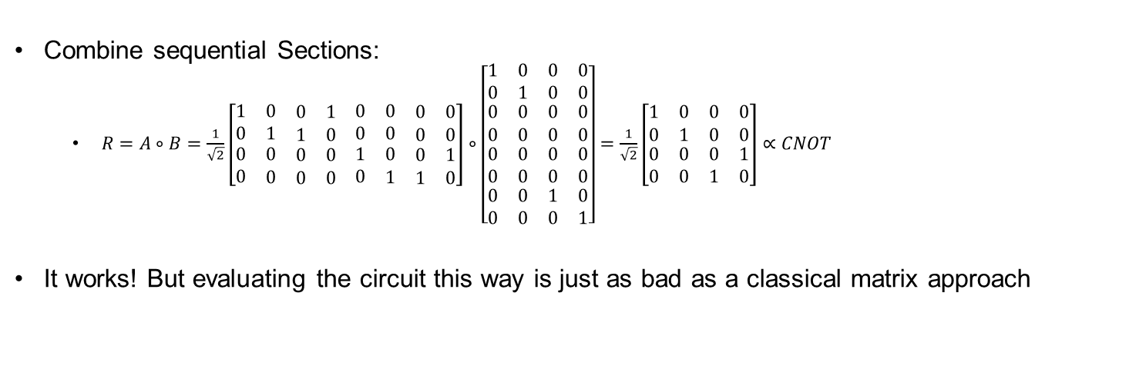
Example: CNOT
Combine sequential Sections:
$$R=A∘B=\frac{1}{\sqrt{2}}\left[\begin{matrix}\begin{matrix}1 & \begin{matrix}0 & \begin{matrix}0 & 1\end{matrix}\end{matrix} \\ 0 & \begin{matrix}1 & \begin{matrix}1 & 0\end{matrix}\end{matrix}\end{matrix} & \begin{matrix}0 & \begin{matrix}0 & \begin{matrix}0 & 0\end{matrix}\end{matrix} \\ 0 & \begin{matrix}0 & \begin{matrix}0 & 0\end{matrix}\end{matrix}\end{matrix} \\ \begin{matrix}0 & \begin{matrix}0 & \begin{matrix}0 & 0\end{matrix}\end{matrix} \\ 0 & \begin{matrix}0 & \begin{matrix}0 & 0\end{matrix}\end{matrix}\end{matrix} & \begin{matrix}1 & \begin{matrix}0 & \begin{matrix}0 & 1\end{matrix}\end{matrix} \\ 0 & \begin{matrix}1 & \begin{matrix}1 & 0\end{matrix}\end{matrix}\end{matrix}\end{matrix}\right]∘\left[\begin{matrix}\begin{matrix}1 & 0 \\ 0 & 1\end{matrix} & \begin{matrix}0 & 0 \\ 0 & 0\end{matrix} \\ \begin{matrix}0 & 0 \\ 0 & 0\end{matrix} & \begin{matrix}0 & 0 \\ 0 & 0\end{matrix} \\ \begin{matrix}\begin{matrix}0 & 0 \\ 0 & 0\end{matrix} \\ \begin{matrix}0 & 0 \\ 0 & 0\end{matrix}\end{matrix} & \begin{matrix}\begin{matrix}0 & 0 \\ 0 & 0\end{matrix} \\ \begin{matrix}1 & 0 \\ 0 & 1\end{matrix}\end{matrix}\end{matrix}\right]=\frac{1}{\sqrt{2}}\left[\begin{matrix}\begin{matrix}1 & 0 \\ 0 & 1\end{matrix} & \begin{matrix}0 & 0 \\ 0 & 0\end{matrix} \\ \begin{matrix}0 & 0 \\ 0 & 0\end{matrix} & \begin{matrix}0 & 1 \\ 1 & 0\end{matrix}\end{matrix}\right]∝CNOT$$
It works! But evaluating the circuit this way is just as bad as a classical matrix approach

Slide 30
Remark: Where to draw Regions?
For larger Graphs there are multiple ways of drawing the regions
Obvious as you are allowed to move the components around (“Only topology mattes”)
This leads to different matrices in the calculation process
But the final matrices are always equivalent up to a scalar factor
Res matrix

Slide 31
Simplification Rules
We don’t want to calculate the graph using its matrix form
There exist many rules to simplify ZX-Graphs
But far fewer rules as for classical circuits
We can apply the rules anywhere in the graph aslong:
The pattern for the substitution matches
The order of the input / output wires of regions are unchanged

Slide 32
Spider Fusion
Idea: Two spiders of the same color fuse together
Can simplify graph a lot
This rule allows to freely change input and outputs!
Only topology matters

Slide 33
Copy Rules
Idea: Green copies red, Red copies green

Slide 34
Hopf Rule
Idea: If two spiders of different color are connected by 2 lines, both lines can be deleted
See XOR / AND reference

Slide 35
Bi-Algebra rule
This rule allows us to break apart “squares” of alternating spiders??

Slide 36
Color Change Rule
Idea: We can change the color of a spider, but we need to add Hadamard gates to all its inputs / outputs

Slide 37
Hadamard Gate
A Hadamard gate can be represented by its euler angle representation
Using the rules from above we can show that two Hadamards cancel eachother

Slide 38
Simplification: CNots
Three Cnots in a row, middle Cnot is flipped
Remember how a cnot is build

Slide 39
Simplification Rules in Action
Apply xxxx rule

Slide 40
Simplification: Bell States
…

Slide 41
Simplification: Quantum Fourier Transform
…

Slide 42
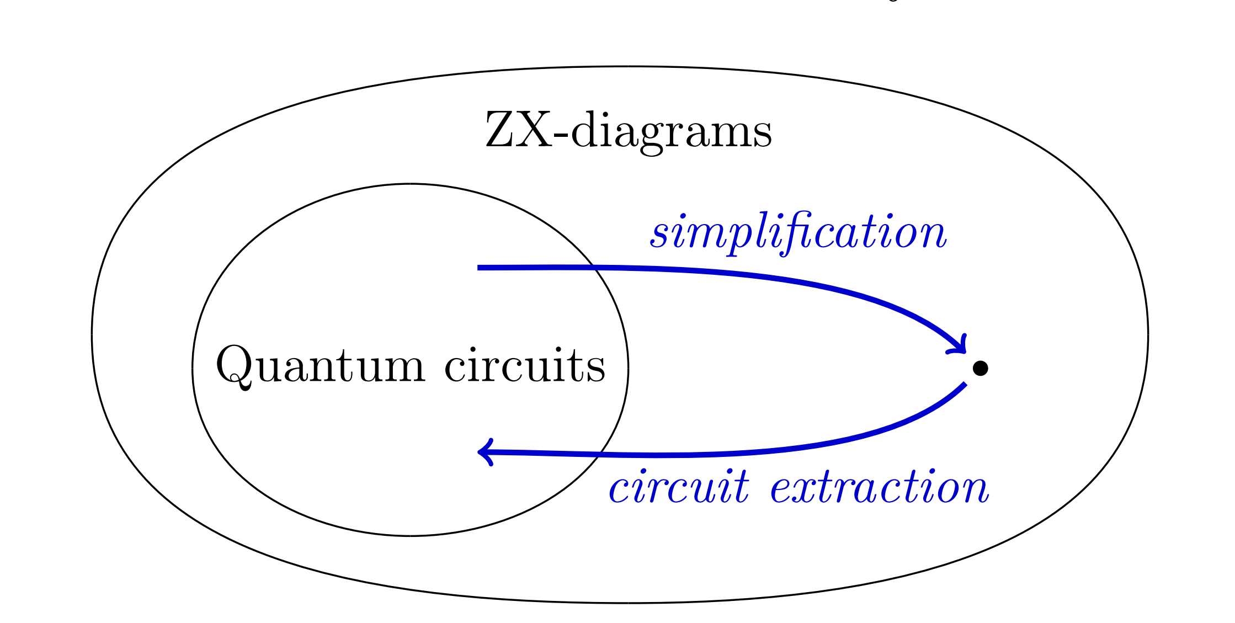
Completeness
ZX Calculus is complete
Any two ZX-Graphs for the same Quantum circuit can be transformed into each other using the rules from above
This means that if a simplified circuit exists, it can be found using zx-calculus
But the path between those transfomrations may traverse invalid quantum circuits
Fig. 5: Simplification Process

Slide 43
Image Sources
Fig. 1: ZX-Circuit https://upload.wikimedia.org/wikipedia/commons/5/50/Zx-diagram-example.svg
Fig. 2: Circuit Identities https://www.cs.ox.ac.uk/people/aleks.kissinger/slides/qnlp-40mins.pdf
Fig. 3: Quantum Compilation https://www.researchgate.net/figure/Quantum-circuit-compilation-47_fig15_348930917
Fig. 4: Fault tolerant Toffoli Gate https://www.researchgate.net/figure/The-fault-tolerant-Clifford-T-implementations-of-quantum-logic-gates-used-in-this-work_fig1_322049116
Fig. 5: Simplification Process https://arxiv.org/pdf/1902.03178.pdf Page 2

